Slide 1









E-Commerce Mobile Application Development
Presentation By:
Varunraj Rachakatla
Nikith Kumar Bandaru
Uday Singamala
Mahesh Gudla
Srikanth Boppudi
Sai Krishna Koduri

Slide 2




Project Outline
Project Title: E-commerce Mobile App Development
Focus: User convenience and engagement
Key Features: User Registration, Product Browsing, Shopping Cart Management, Order Tracking
Technologies: React Native, MongoDB
Objectives: Seamless Shopping Experience, Business Growth
Scope: iOS and Android App Development, Key Feature Implementation, UX/UI Optimization
Testing: Functional, Usability, Performance, Security
Deployment: App Store (iOS), Play Store(Android)
Maintenance: Bug Fixes, Feature Updates

Slide 3





Introduction
The project aims to develop a feature-rich and user-friendly mobile application for e-commerce, catering to the growing demand for convenient and accessible shopping experiences. The mobile app will provide users with a seamless platform to browse, select, and purchase products on the go.

Slide 4




Problem Statement
The emergence of monopolistic market structures in the e-commerce industry, driven by major players like Amazon and Alibaba, presents significant challenges for smaller merchants and consumers alike. These industry titans leverage their vast resources and cutting-edge technologies to dominate the market, resulting in limited competition, reduced variety of items, and restricted customer choice. Small and local sellers face obstacles in competing effectively due to the lack of technology infrastructure and financial resources, leading to market consolidation and diminished diversity. To address these challenges, innovative solutions are needed to support local merchants and foster competition. Introducing a subscription-based application platform on mobile devices could provide a viable solution, empowering small businesses to compete more effectively while offering consumers greater choice and diversity in the marketplace.

Slide 5



Proposed Solution
Develop a feature-rich mobile application with intuitive navigation.
Ensure compatibility with various mobile platforms (iOS and Android)
Implement a secure payment gateway for safe transactions.
Provide real-time notifications to keep users informed.
Optimize the user interface and experience for seamless shopping.

Slide 6


Functional Requirements
Non-Functional Requirements
Authentication and Security
User Account Management
Vendor Management
Navigation and User Experience
Product Management and Search
Order Fulfillment and Payment
Security and Privacy Measures
Additional Features
Performance
Security
Stability
Availability
Scalability
User Experience
(UX)
Compatibility
Usability
Network Resilience
Compliance
Sustainability
Backup and Restoration

Slide 7

Data Management Plan
The Data Management Plan for Storegrab's e-commerce application outlines a meticulous strategy to uphold the integrity, security, and accessibility of critical data entities. It begins by introducing the plan's significance in ensuring seamless app functionality. Key data entities such as Users, Inventory, Vendors, Orders, Payment, and Ratings & Reviews are detailed, including their respective fields and types. Access control measures and data security protocols, including user verification and encryption, are outlined to prevent unauthorized access and maintain confidentiality. Additionally, functional requirements for efficient data storage and retrieval, along with extra features like search functionality and recommendation systems, are discussed. The plan concludes by stressing the importance of adhering to these guidelines to safeguard data integrity and enhance user experience.

Slide 8

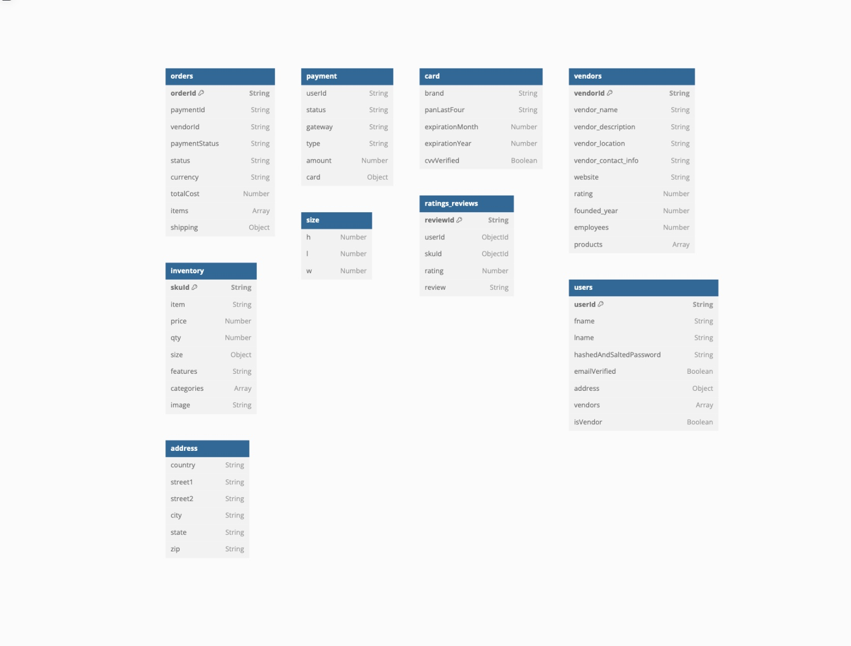



Database Schema Demo

Slide 9


Conclusion
Accomplishments
Developed a feature-rich e-commerce mobile application to address outlined challenges.
Implemented functional and non-functional requirements for seamless user experience.
Established robust data management plan for security, integrity, and availability.
Designed intuitive home page and navigation screens for enhanced user engagement.
Lessons Learned
Importance of efficient resource management within budget and timeline constraints.
Compliance with regulations and app store guidelines for successful deployment.
Need for continuous improvement and adaptation based on user feedback.
Collaboration and communication among team members for successful project execution.

Slide 10


Thank YOU

